Slide 1

International Conference on Smart Systems for applications in Electrical Sciences ICSSES-2024
Siddaganga Institute of Technology, Tumakuru
Association of Electrical Sciences
“Image Processing based Traffic Surveillance”
By
Mithun J B
Co-authors:-
A N Mukunda Rao, D K Chandrakanth, Preetham G M, Siddharth Prabhu
Date: 04/05/2024
Paper ID: 756

Slide 2
Contents
Introduction
Objectives
Motivation
Literature Review
Summary
Methodology
Results and Discussion
Conclusion
Reference

Slide 3
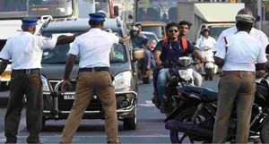
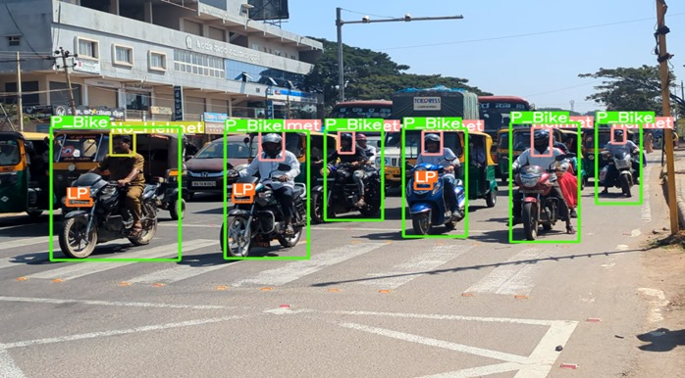
Introduction
India witnessed an 18% increase in vehicle ownership in 2023.
This increase resulted in a 12% rise in road accidents and deaths.
Incorporating law enforcement will be challenging.
To address this issue, we propose a fully functional traffic surveillance monitoring system.
Fig.1. Manual traffic monitoring [1].
Fig.2. Automatic traffic monitoring.

Slide 4
Objectives
The objective of this project is to extract the License plate information of the bike and car which violate the traffic rules such as,
Riding bike without a helmet.
Triple riding on bike.
Mobile phone usage while riding the bike.
Bike and car surpassing over the zebra crossing lane in a traffic signal.

Slide 5
Literature review
SL.NO. | Author | Year | Topic | Overview
1. | Dahiya .K, Singh D, Mohan C.K. | 2016 | Automatic detection of Bike-riders without helmet using surveillance videos in Real-time. | Detection of motor-cyclists from surveillance video using object segmentation. Determination of helmeted and non-helmeted riders by binary classifier.
2. | Madhuchhanda Dasgupta. | 2019 | Automated Helmet Detection for Multiple Motorcycle Riders using CNN. | Motorcycle riders detection by CNN (Bounding boxes, Euclidean distance). Softmax classifier for Helmet detection.
3. | Xue-Hua Wu, Renjie HU. | 2019 | Block-Based Hough Transform for Recognition of Zebra Crossing in Natural Scene Images. | Block based Hough transform is used to recognize the parallel and straight lines, this detected lines adapted to recognize Zebra crossing.
4. | Mistry, Jimit, Aashishk | 2014 | An automatic detection of helmeted and non helmeted motorcyclists with license plate extraction using CNN. | YOLOv2 is implemented for helmet detection. Open ALPR used for license plate extraction.

Slide 6
Summary
Limitations of the Work:
Current methods are not very accurate, slow, and complex.
Most papers focus on specific tasks, creating fragmented solutions.
Integration for Comprehensive Approach:
To overcome limitations, the proposed project integrates different tasks into one comprehensive model for traffic safety enforcement.
Selection of YOLOv8:
YOLO models are chosen for traffic violation detection due to their speed and accuracy.
YOLOv8 is selected for its ability to be trained on larger datasets and its Multi-Scale Feature Fusion for detecting small objects.
The model's anchor-free bounding box detection capacity aids in non-maximum suppression (NMS) for faster processing, improving both speed and accuracy.

Slide 7
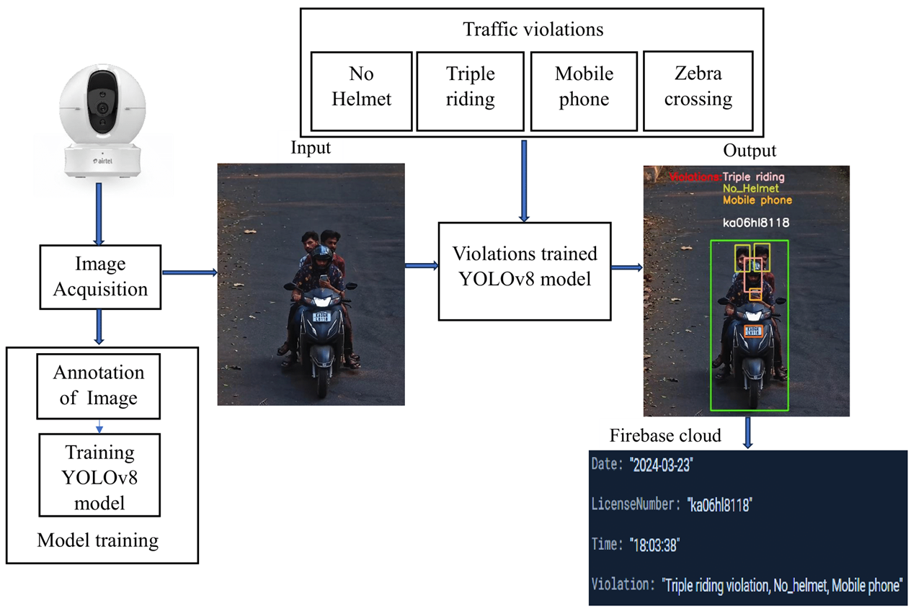
Methodology
Fig.3 Block diagram of the system.

Slide 8
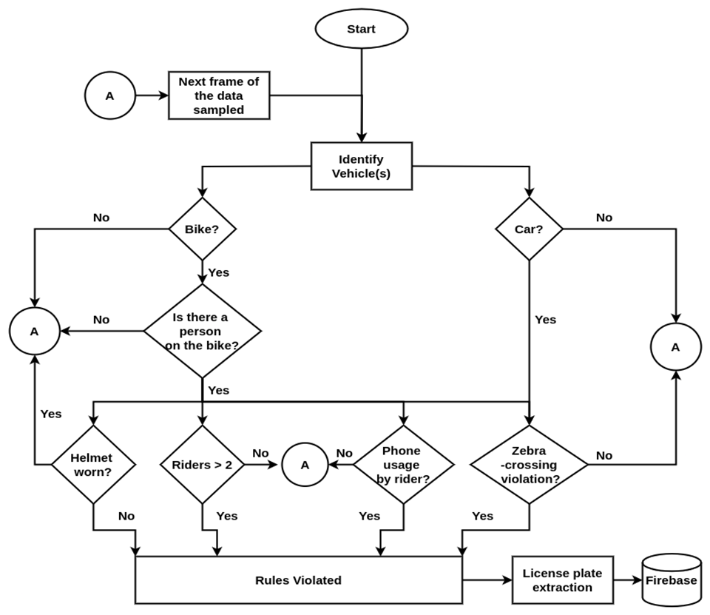
Methodology (Contd..)
Fig.4. Work flow of the proposed system

Slide 9
Methodology (Contd..)
Dataset gathering :
Captured video from a 4MP camera at 30 fps.
Extracted a total of 2300 images from 50 videos.
Annotation of images :
Annotated the images with a total of 9967 instances using Roboflow.
Resized the images to 640 x 640.
Split the dataset into 80% for training and 20% for testing.
Model training :
The training was conducted over 100 epochs using the YOLOv8n model in Google Colab.

Slide 10
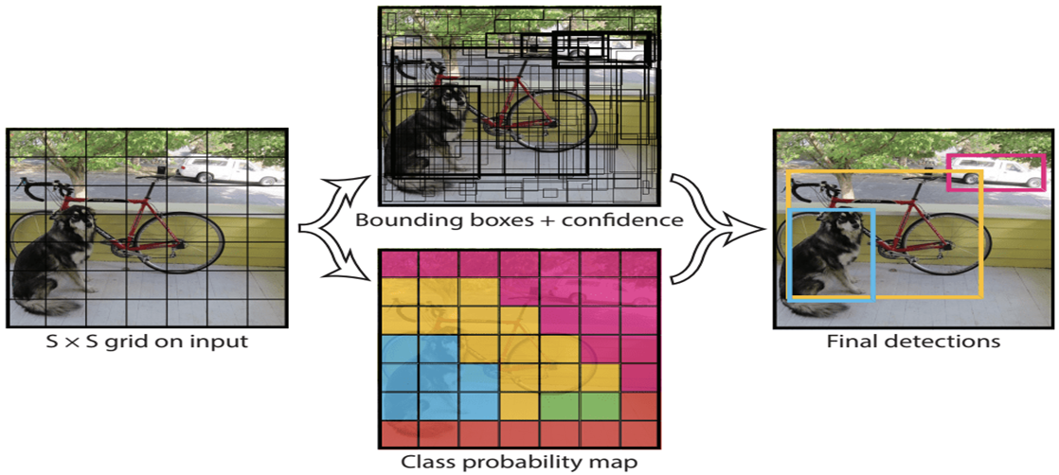
Methodology (Contd..)
Prediction :
Feature Extraction
Multi-Scale Feature Fusion
Grid Division (S x S)
Bounding Box and class probabilities Prediction
Non-Maximum Suppression
Visualization :
Drawing bounding boxes
Labelling names and confidence scores.

Slide 11
Methodology (Contd..)
OpenALPR model framework for license plate information extraction.
Image Acquisition
Image Preprocessing
License Plate Localization
Character Segmentation
Character Recognition
Fig.2. LPR model framework.

Slide 12
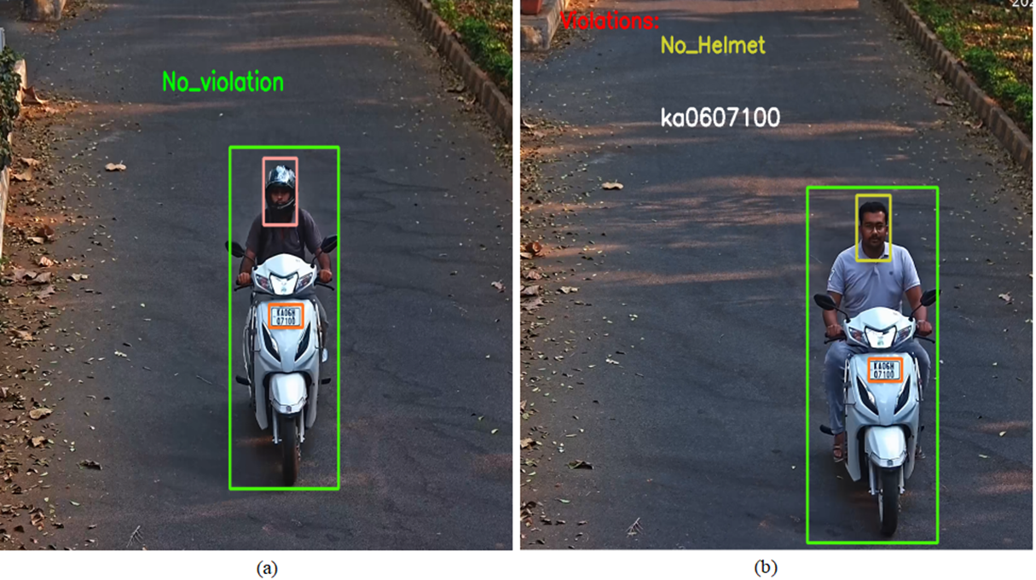
Results and Discussion
Detecting helmeted and no helmeted rider.

Slide 13
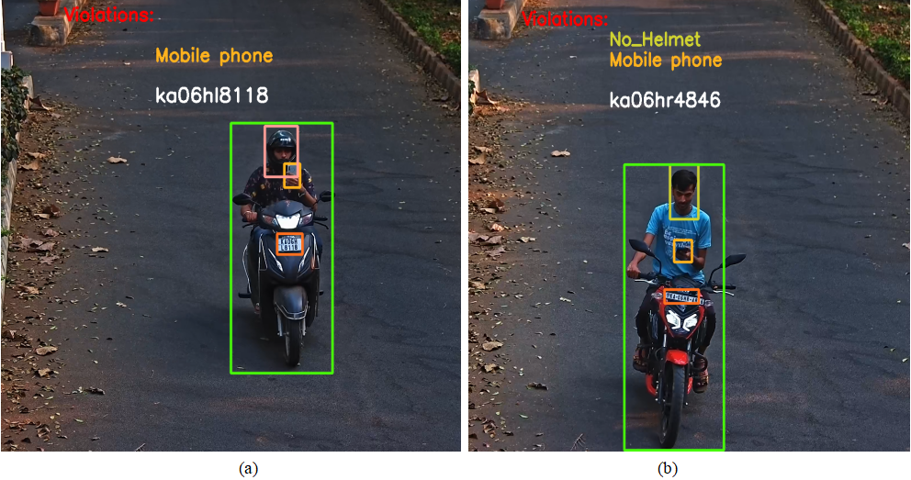
Results and Discussion (Contd..)
Detecting bike rider using mobile phone.

Slide 14
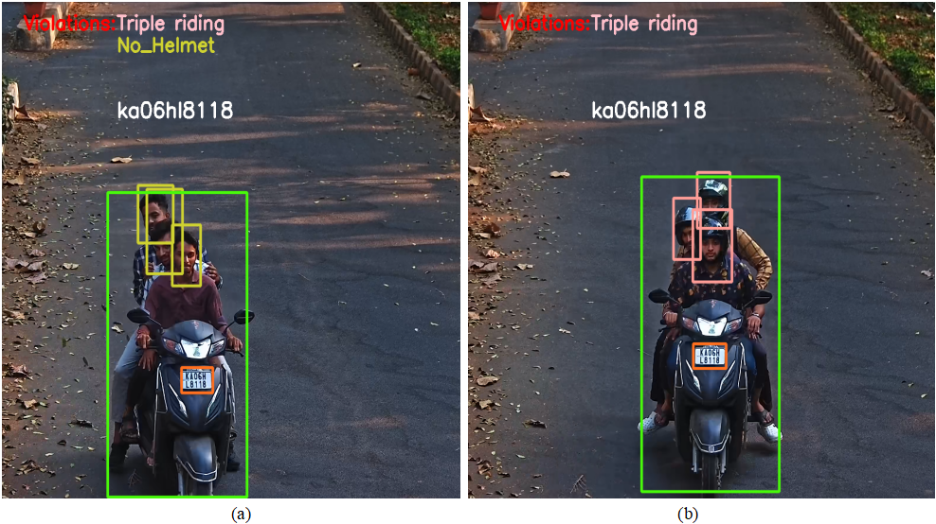
Results and Discussion (Contd..)
Detecting the instances of triple riding.

Slide 15
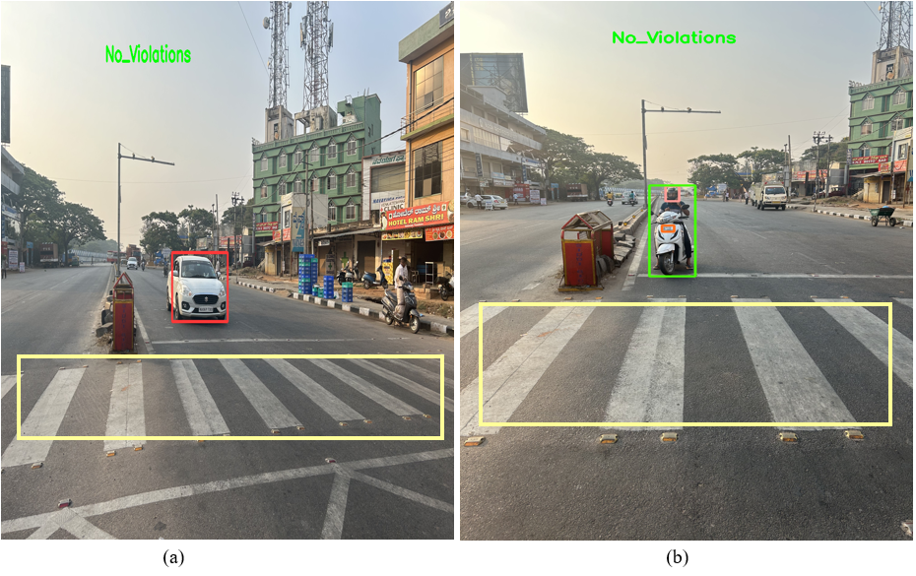
Results and Discussion (Contd..)
No zebra cross lane violation.

Slide 16
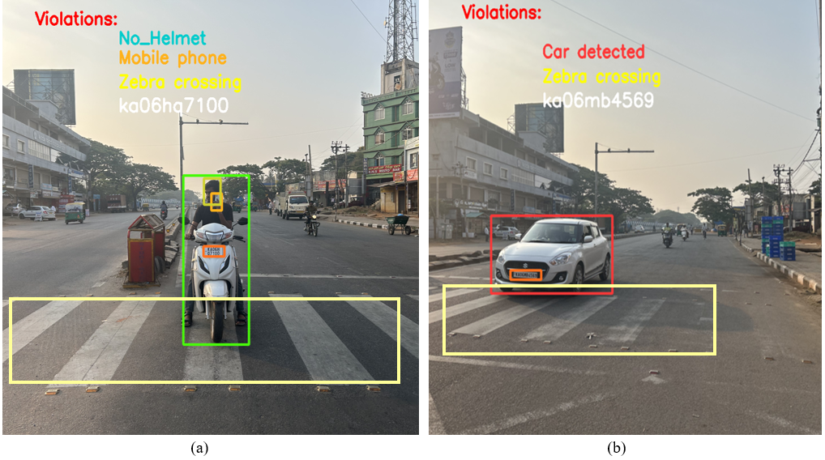
Results and Discussion (Contd..)
Detecting vehicle surpassing over zebra crossing lane.

Slide 17
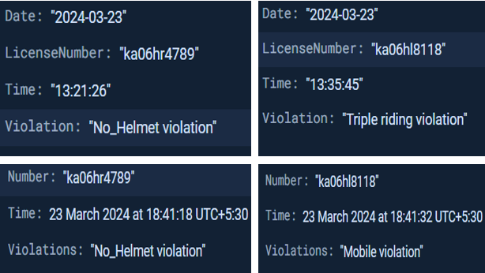
Results and Discussion (Contd..)
Rule violators information in Firebase cloud.

Slide 18
Results and Discussion (Contd..)
The model achieves a 99% detection rate for bikes and riders, distinguishing helmeted riders with 99% accuracy and non-helmeted riders with 98% accuracy.
Additionally, it detects mobile phone usage with an accuracy of 98% and also identifies instances of more than two riders on a bike with 96% accuracy.
The system recognizes the license plate information of the vehicle with an accuracy of 93%.
Overall, the system achieved 97% accuracy in detecting traffic rule violators.
The results are stored in the Firebase Cloud with a violations committed by the rider along with the date and timestamp.

Slide 19
Conclusion
The system automatically detect traffic violations using the YOLOv8 model, effectively identifying infractions such as riding without a helmet, triple riding and using a mobile phone while riding a bike .
By extracting license plate details in each scenario, law enforcement agencies can efficiently enforce penalties and promote safer road, ultimately contributing to a reduction in road accidents and fatalities.
This project minimizes the need for manual monitoring of traffic scenes by traffic officers.

Slide 20
References
[1]. K. Dahiya, D. Singh and C. K. Mohan, "Automatic detection of bike-riders without helmet using surveillance videos in real-time," 2016 International Joint Conference on Neural Networks (IJCNN), Vancouver, BC, Canada, pp. 3046-3051, 2016.
[2]. M. Dasgupta, O. Bandyopadhyay and S. Chatterji, "Automated Helmet Detection for Multiple Motorcycle Riders using CNN," 2019 IEEE Conference on Information and Communication Technology, Allahabad, India, pp. 1-4, 2019.
[3]. X. -H. Wu, R. Hu and Y. -Q. Bao, "Block-Based Hough Transform for Recognition of Zebra Crossing in Natural Scene Images," in IEEE Access, pp. 59895-59902, 2019.
[4]. Mistry, Jimit, Aashishk and kishor P. Upla. “An automatic detection of helemeted and non helemeted motorcyclists with license plate extraction using CNN.”, in International Electrical Engineering Congress (iEECON), Chonburi, Thailand, pp. 1-6, 2014.

Slide 21
References
[5]. Mallela Nikhil Chakravarthy, Rohit Volety, and Nadesh R.K., "Detection of the triple riding and speed violation on two-wheelers using deep learning algorithms", Multimedia Tools and Applications, Springer, pp. 8175-8187, 2021.
[6]. A. Saumya, V. Gayathri, K. Venkateswaran, S. Kale and N. Sridhar, "Machine Learning based Surveillance System for Detection of Bike Riders without Helmet and Triple Rides," 2020 International Conference on Smart Electronics and Communication (ICOSEC), Trichy, India, pp. 347-352, 2020.
[7]. H. Lin, J. D. Deng, D. Albers and F. W. Siebert, "Helmet Use Detection of Tracked Motorcycles Using CNN-Based Multi-Task Learning," in IEEE Access, pp. 162073-162084, 2020.
[8]. H. Shi and D. Zhao, "License Plate Recognition System Based on Improved YOLOv5 and GRU," in IEEE Access, pp. 10429-10439, 2023.

Slide 22
THANK YOU..

